Slide 1
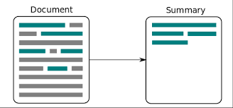
NLP Based Article Summarization [Group no 6]

Slide 2
Group Members and Guide
GUIDE : SHWETA . A . PATIL
MEMBER 1 : FRESHIN FRANCIS
MEMBER 2 : ABIN VARGHESE JACOB
MEMBER 3 : GAIKAR PRATEEK BALU
MEMBER 4 : VETTITHANAM ALEX SEBASTIAN

Slide 3
INTRODUCTION
PROBLEM STATEMENT
CONTENTS
LITERATURE REVIEW
EXISTING METHODS
PROPOSED SYSTEM
CONCLUSION AND FUTURE SCOPE

Slide 4
INTRODUCTION
A summary condenses a lengthy document by highlighting salient features
The main goal of news article summary is, the readers to walk away with knowledge on what the article is all about without the need to read the entire article
This proposes a article summarization system
The summarization process involves filtering, highlighting and organizing information which is concise, coherent and faithful to the original document

Slide 5
PROBLEM STATEMENT
Creating a NLP based extractive text summarization :
Divide entire article as a group of sentences, which acts as the dataset for further processing. Detecting semantic similarity between sentences so as to eliminate factual redundancy in summary. Clustering similar sentences to distinguish between semantically different sentences. Picking sentences amongst clusters which represent the information presented by the corresponding cluster

Slide 6
LITEATURE REVIEW
Paper, Author Names and Year | Summary
News Article Summarization: Analysis and Experiments on Basic Extractive Algorithms (June 2020) Tameem Ahmad, Sayyed Usman Ahmed, Nesar Ahmad, Areeba Aziz, Lakshita Mukul | This work gives the details of extractive text summarization for newspaper articles using three different algorithms i.e., Lexical Chain, TF-IDF, Text Rank One can combine several sentence scoring algorithms into one single system which will incorporate the diverse features of these algorithms

Slide 7
Paper, Author Names and Year | Summary
Automatic News Article Summarization (Feb 2018) Laxmi B. Rananavare, P. Venkata Subba Reddy | This work presents a system to automatically collect, collate and summarize online newspaper articles based on a user submitted query. Using pre-processing steps like Sentence tokenization, NER, Stemming and lemmatization and Triplet formation; the articles are broken down into manageable semantic atoms

Slide 8
Paper, Author Names and Year | Summary
Machine Learning Approach for Automatic Text Summarization Using Neural Networks (Jan 2018) Meet Kumar Patel, Adwaita Chokshi, Satyadev Vyas, Khushbu Maurya | In this research work, we have explored the machine learning approach to text summarization and have presented a range of novel models using neural networks. In this proposal, we have employed different models with variety of datasets, for trainable text summarizers using Keras and TensorFlow libraries and have analyzed all the results.

Slide 9
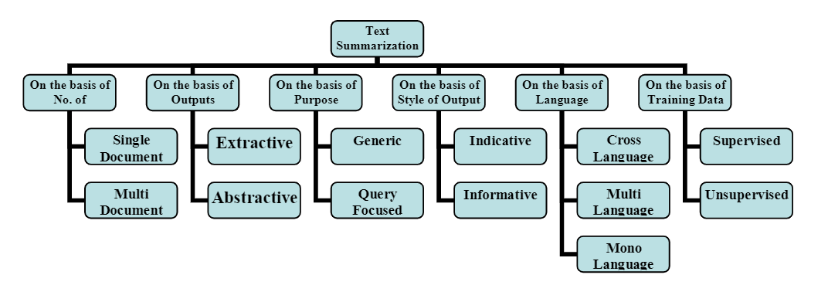
SURVEY OF EXISTING METHODS

Slide 10
SURVEY OF EXISTING METHODS
Extractive summaries have been more frequently generated and used in practical applications
Some methods used to generate extractive summaries are:
1. Statistical-based methods 4. Topic-based methods
2. Graph based methods 5. Machine learning based methods
3. Discourse based methods 6. Optimization based methods

Slide 11
PROPOSED SYSTEM
Extractive summarization is used to generate summaries by encountering the important sentence from original document and then combining them.
The summarization system consists of 3 steps
1. Pre-processing
2. Feature terms extraction
3. Sentence ranking based on optimized weight

Slide 12
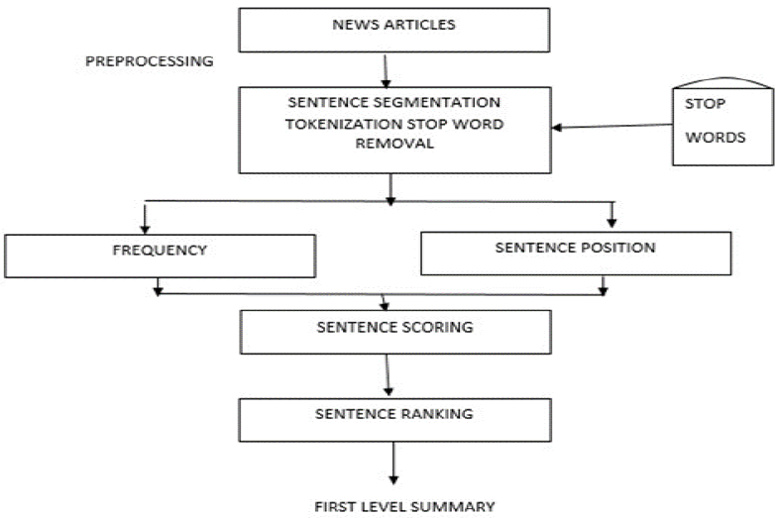
BLOCK DIAGRAM

Slide 13
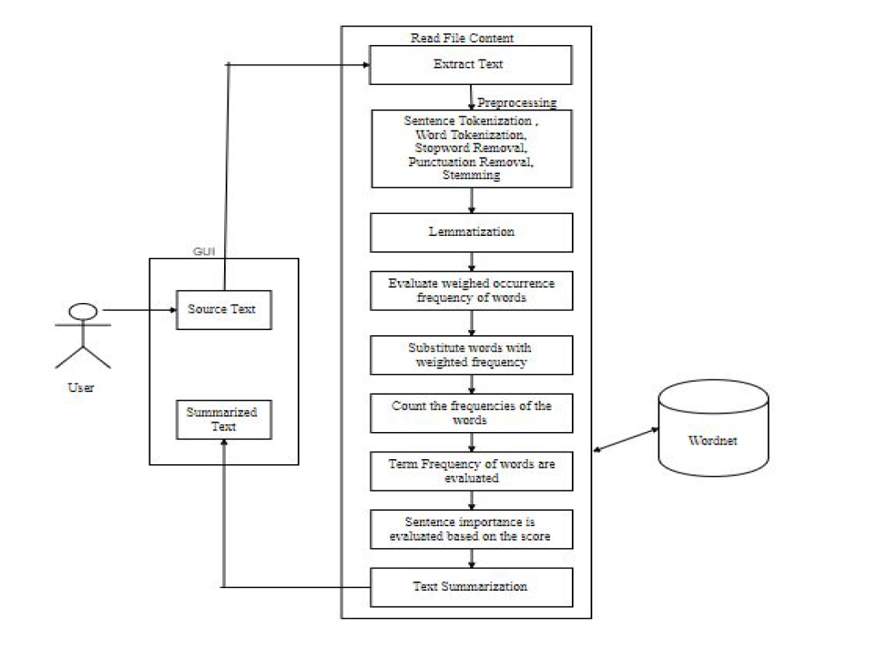
PROCESS DESIGN

Slide 14
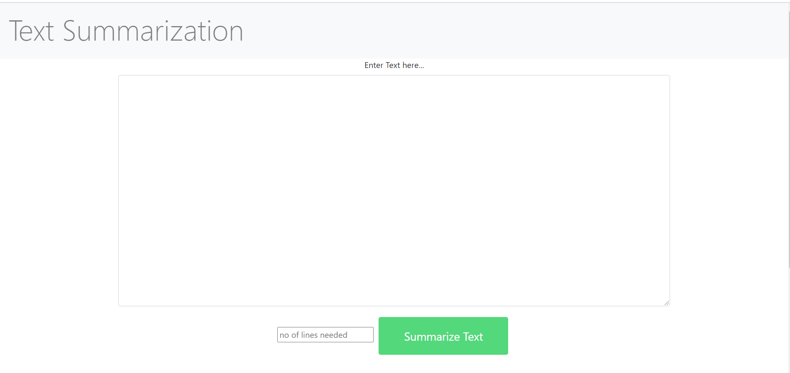
Homepage

Slide 15
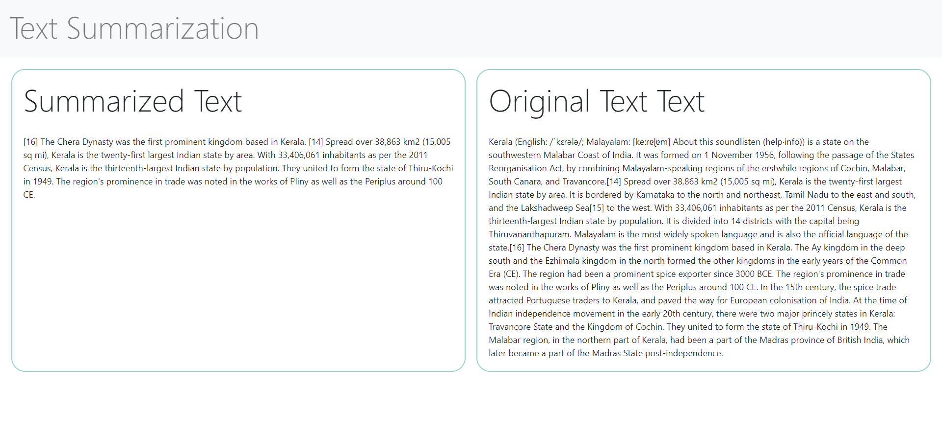
IMPLEMENTATION

Slide 16
CONCLUSION
Text summarization is one of the major problems in the field of Natural Language Processing
Extractive summarization is used for summarizing
The project uses various libraries to provide a summary of the given text while preserving the original meaning of the input document
To speed up the summary generation, a preprocessing approach is introduced

Slide 17
FUTURE SCOPE
Summarizing news article from multiple sources
Applying Sentiment Analysis to summarized news articles
Combining Extractive and Abstractive methods
Translating the summary to multiple languages
Integrating with other news websites
Two Level Summary

Slide 18
REFERENCES
https://www.researchgate.net/
https://www.analyticsvidhya.com/blog/2018/11/introduction-text-summarization-textrank-python/
https://towardsdatascience.com/how-to-create-simple-news-summarization-from-scratch-using-python-83adc33a409c
https://machinelearningmastery.com/prepare-news-articles-text-summarization/
https://stackabuse.com/text-summarization-with-nltk-in-python/

Slide 19
Thank You

